Slide 1
Why is implementing requirements so hard?
Peter Ritchie, Desert Code Camp 2019
Notes:
Software project failures are making front-page news. But even with agile, it seems that fulfilling requirements is a herculean task. Maybe the answer is in the statement? Join me in looking at how the software industry has failed at fulfilling requirements and some of the ways it is believed to have caused those failures. Without understanding history, we're doomed to repeat it; but we'll also continue to look at details ways of addressing the problem. We'll then round things out by moving past the subjective into the objective to detail some techniques all of us can use that truly help manage the symptoms causing the problems.

Slide 2
Me and this topic
Platform Strategist, Quicken Loans
Previously operated my own consulting company providing software-related services to several clients
Started technologist (programming) career in 1989
Written three books (relating to Visual Studio)
Previously Microsoft MVP (C#, Developer Technologies, …)
Have been nitpicky about this topic for a couple years, and naming things (you’ll notice parts-of-speech references…)
Peter.Ritchie@Outlook.com
http://blog.PeterRitchie.com
Twitter: @peterritchie
LinkedIn in/peteraritchie/

Slide 3
Agenda
Challenges with “requirements”
What are we missing?
How to distill requirements down to needs then goals
Other techniques
Review
Questions, answers, comments, feedback
Notes:
Enemy
Why now?
What does success look like?
Explain how obstacles will be handled
Evidence that it will succeed

Slide 4
Challenges with “requirements”

Slide 5
Subjectivity
Pre-solutioned
Open to interpretation
Assumptions (this means you too)
Unprioritized = all high priority
Unclear scope

Slide 6
Inconsistent vocabulary
If there is not a clear understanding of the domain vocabulary, the intent of the requirement will be missed
Starts with “Requirements”, are they:
Business Vision?
Product Vision?
User requirements?
Functionality?
Quality attributes?

Slide 7
Lack of ownership
A requirement lacking ownership will deviate from intentions and goals
Engineers should recognize ownership is not theirs:
Work with the owner to ensure clarity of what needs to be done
Work with the owner to be aligned on what “done” means
If ownership is unclear, the engineer should find a sponsor
If the requirement is important, finding a sponsor and clear ownership should be easy.
Avoid assumptions

Slide 8
Lack of accountability
No one is tasked with responsibility to complete
No time is allocated to perform the task
Unclear priority
Ineffective execution

Slide 9
What are we missing?

Slide 10



lifecycle
NOT throwing requirements over the wall
Notes:
Requirements are not milestones on their own, they have a lifecycle

Slide 11
Iterative
collect
validate
experiment
evaluate
refine
Notes:
Requirements are collected, validated, experimented with to evaluate and refine

Slide 12

Collaborative
Notes:
The lifecycle is collaboration with many roles. The result of delivering requirements is the end result of the work of engineers, and they can take lead on that collaboration with requestor, stakeholders, product owner, architect, program management, marketing, etc.

Slide 13
How to distill requirements down to needs then goals

Slide 14
validation
Collaborative is a back-and-forth of reality and clarity
Garbage in, garbage out
Work with the requirement owner to get clarity and correctness
Regardless of why garbage came out, we’re responsible for the quality of the implementation

Slide 15
Point of Success
To ensure your work is respected and viewed with the highest quality,
control the inputs that contribute to your results
Control the inputs that contribute to your results

Slide 16
Different kinds of requirements
Vision
Theme
Product
Solution
Hypothesis
Capability
Feature
User story
Notes:
Different requirements rely or build from others or are cumulative

Slide 17
Vision
Inspirational
Directional, but not exact
Guardrails but abstract constraint
Superlative: “Best at ____.”
Comparative: “To make ____ better.”
Everything should align with vision
Notes:
Things that don’t align well with the vision indicate they’re not clear or low-priority

Slide 18
Vision - nitpicky
Noun, superlative, comparative, description, …
Templates:
[Several years in the future,] <noun> will ____ {by ___ | that ___}
“We will help people live longer, healthier, happier lives”
[We image] <noun> with <description>
“We imagine a healthy, prosperous world in which societies are forever committed to caring for and valuing nature, for the long-term benefit of people and all life on Earth”
To [be] <verb>|<adjective>
“To fulfil dreams through the experiences of motorcycling”
“[To be] The enablers of global e-commerce”
Notes:
CVS
Harley-D
UPS

Slide 19
Theme
Optional, generally a higher-up, “marketing” target
Should be broad or addresses a large objective
Fits within Vision and doesn’t simply repeat it
Should involve direct business value, not just technological value
Examples:
Cloud and mobile first
Integrate with SAP

Slide 20
Product
A manifestation or realization of related capabilities
Similar to a stable theme
Usually guided by its own vision
Generally prioritized with a Roadmap
Features added to product should make sense and not feel out of place

Slide 21
Roadmap
Typically longer-term expectations
3 or more months out
Delivery Milestones
Plans for implementing features, themes, etc.
Does not include everything
Things in roadmap should have priority over those that aren’t

Slide 22
Solution
Templates
For <persona> who <does something> the <solution> is a <something/the-how> that <provides this value> unlike <current or competition>, our solution <is better, why>.
We believe that <business outcome> will be achieved if <user> attains <benefit> with <feature>

Slide 23
Hypothesis
Something that’s never been done before is best viewed as a hypothesis
Convey the fact that estimation and expectations are speculative
A proposed “solution”
The expected value (outcome, output, etc.)
Compare to existing abilities/features
Must be measurable, apply to a problem, align with vision, etc.

Slide 24
Hypothesis - nitpicky
“For third-party contractors who make changes to our data, the Snowball Epic is a streamlined workflow that provides 24/7 access to a secured portion of our database. Unlike the current ZIP file export/import model our solution is more stable, has a shorter cycle time, and increases transparency”
“We believe that an increase in Overdraft applications of 25% will be achieved if customers that often go overdrawn can apply for a flexible short-term loan with a quick apply mobile Overdraft feature.”
Templates
For <persona> who <does something> the <solution> is a <something/the-how> that <provides this value> unlike <current or competition>, our solution <is better, why>.
We believe that <business outcome> will be achieved if <user> attains <benefit> with <feature>

Slide 25
Capability
Applies to an ability to do something requiring expertise and resources
Shouldn’t merely be a function, may be cross-function and cross-role
Function: Accounting (a grouping of skills)
Capability: Sell new products (outcome based)

Slide 26
Capability - NitpickY
Action noun, de-verbal noun phrase

Slide 27
Feature
Different from functionality, but generally applies to functionality
Usually sought after, distinctive, differentiating from competition
Relates to or describes attributes of something (product, functionality)
E.g. quality attributes
Generally nice-to-have, over and above core functionality.
Represents value, fits with vision/theme/product, etc.

Slide 28
Feature - nitpicky
A noun or adjective (or has forms of either)
Noun: used as adjective, a “noun modifier”
Can be modified with comparatives (better) and superlatives (best)
Examples:
Dark UI
Fastest Recognition Capabilities

Slide 29
User story
Natural language description of features or functionality that provides benefit to a specific user type/role.
Templates
As <type of user>, I can <capability/goal>, so that <some reason>.
In order to <receive benefit> as a <role> , I can <goal/desire>
Can include one or more acceptance criteria (beyond reason/goal)
Given, when, then:
Given <some context> , when <action performed> [and <action performed>…], then <observable consequence> [and|or <observable consequence>…]

Slide 30
User story - nitpicky
Should be able to rephrase on form to another
Should be actionable, or be broken down into more detailed stories
Reason/goal should be measurable
Actionable stories should include measurable criteria (given, when then)
Example:
Given my bank account is in credit, and I made no withdrawals recently, when I attempt to withdraw an amount less than my card’s limit, then the withdrawal should complete without errors or warnings

Slide 31
Point of success
Analyze requests and ensure they have previous attributes. If not, ASK FOR MORE INFORMATION

Slide 32
Narrowing scope
Vision
Theme
User Story
Product
Feature
Solution
Capability

Slide 34
Point of success
The more detail you can get as early as possible improves resulting success

Slide 35
Implementing something no one needs

Slide 36
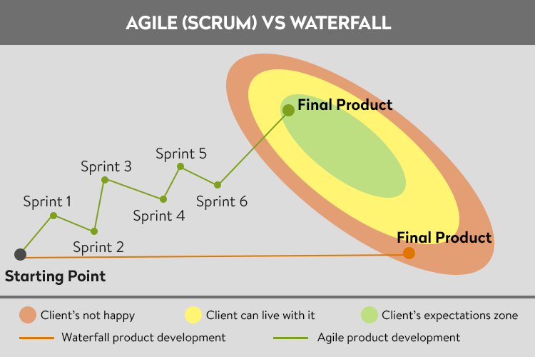
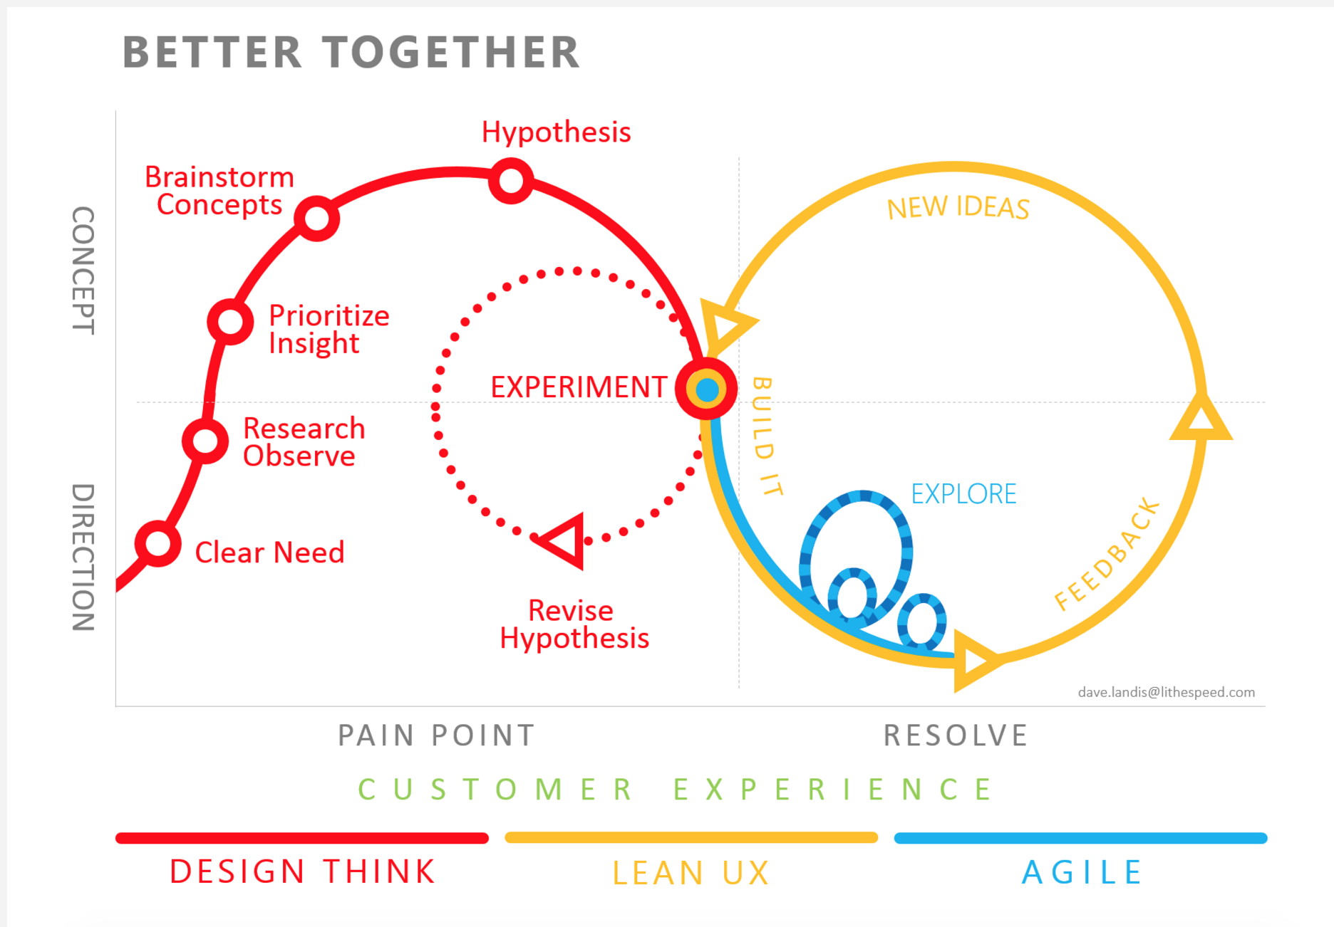
Target based on initial accuracy
Actual delivery

Slide 37



Tracing (validation)
Implementation
Notes:
Ideas, requirement, target should be periodically traced to help ensure things are still aligned

Slide 38
Other techniques

Slide 39
Fantastic requirements
Focused
Apparent
Necessary
Truthful
Attainable
Straightforward
Testable
Independent
Correct

Slide 40
Focused
Focused on one thing
A request to do one thing
Well aligned with broader/predecessor requests

Slide 41
abstract
Free from implementation details
Should not contain unnecessary design information
Requirements need to have solutions designed
Engineer’s expertise is to understand technology
Design technological solution to suit those needs

Slide 42
Necessary
Relevant
Adds obvious value
If the requirement was not implemented, it wouldn’t affect the system?

Slide 43
Truthful
Correct and complete

Slide 44
Attainable
The organization has the skills and resources to fulfil the requirement

Slide 45
Straightforward
Contains no unnecessary complexity
Easy to understand, actionable

Slide 46
Testable
Verifiable
How to measure complete and successful is clear and objective
Measurable

Slide 47
Independent
Independent of other requirements
A requirement should be actionable alone
Nonredundant, not overlapping with another requirement

Slide 48
Correct
Facts within the requirement must be accurate and error-free

Slide 49
How to distill requirements down to needs then goals

Slide 50
Adding value
Requests to add value
Solves a “problem” (what is the problem?)
A problem for a specific “user” or “type of user” (who is this for?)
The solution to the problem (what is the benefit?)
An abstract feature name (what do we call this?)
Assumptions (what are the risks?)

Slide 51
What does success mean?
A scope (what is the simplest thing we can use to prove the idea?)
Showing success (what can we measure to prove success?)
“Experiments” take time, knowing it won’t work in advance (what indicators can we use to tell us if we’re on the right track?)
Quality expectations? (expected throughput, resource usage, speed, fault-tolerance, etc?)

Slide 52
Leading indicators
Different from key performance indicators (KPIs)
KPIs are conformational, confirm things in progress or occurring (lagging)
Indicator of past performance
An output measurement
Leading indicators point towards or predict future events
A measurement that can predict an output measurement
Examples
Goal
Increase revenue from new accounts
KPIs
sales per period
revenue, etc.
Leading indicators
decreased registration time
customer satisfaction
Examples
Goal
Increase registration performance
KPIs
Registrations per period
Total registrations
Leading indicators
Decreased queue utilization
Increased tasks per second

Slide 53
Point of success
Do not use leading indicators for Key Performance Indicators

Slide 54
Review

Slide 55
Review
Be FANTASTIC
Gain clarity with unique requirement types and boundaries
Understand attributes of each requirement type
Check how a requirement was cumulative, clarify “predecessors”
Accuracy improves with time
Embrace side effect of improved accuracy: change
Own your results, don’t le lack of certain minimize your work
Measure success with end goals, predict with mean goals

Slide 56
Be FANTASTIC
Accuracy improves over time
Recognize and embrace change as side-effect of improved accuracy
Improve clarity with unique requirement types and boundaries
Understanding attributes of each requirement type
Own your results, don’t let lack of certainty minimize them
Measure success with end goals, predict it with means goals
Notes:
YOU PROBABLY NEED TO ASK FOR THIS INFORMATION

Slide 57
Questions, answers, comments, feedback

Slide 58
More information
Behavior-Driven Design (BDD): Given, when, then
User story templates: https://lynk.at/story-templates
Given, when, then examples: https://lynk.at/gwt
Slides:

Slide 59
Thanks for listening!

